Slide 1
Quantum Algorithms and Monte Carlo
Mark Dubynskyi

Slide 2
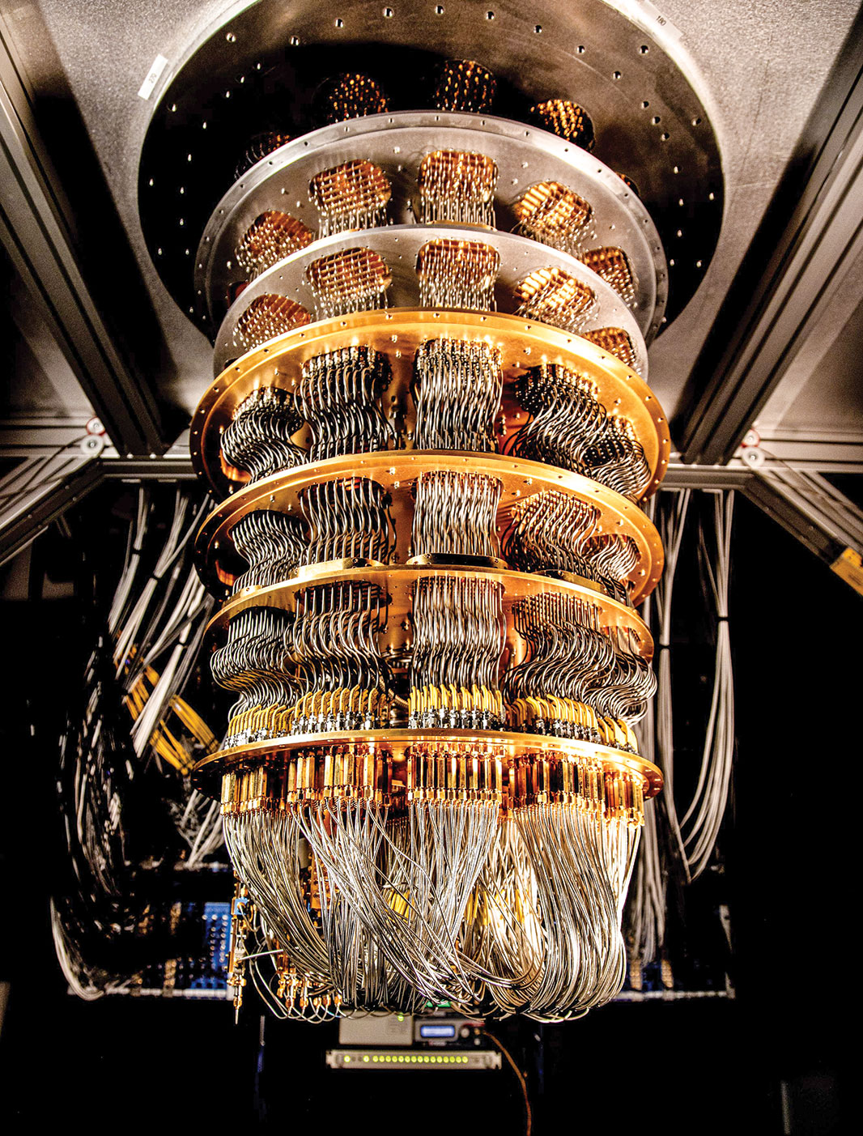
What is Quantum Computing?
Regular computers use bits to process and store information. A bit can be either a 0 or a 1.
Quantum computers use a different unit of information called a quantum bit or qubit. A qubit can be both 0 and 1 at the same time, thanks to a property called superposition.
They can process vast amounts of information and solve complex problems much faster than regular computers.

Slide 3
Monte Carlo Principle
The Monte Carlo principle is a technique used in quantum computing to approximate solutions to problems that are difficult to solve exactly.
Consider a square with side length 2r, where r is the radius of a quarter circle inscribed within the square. So its area is 1/4πr^2.
Randomly generate points within the square,determine how many points fall inside the quarter circle
The ratio of points inside the quarter circle to the total points generated is approximately equal to the ratio of the quarter circle's area to the square's area:π≈4× M/N
​

Slide 4
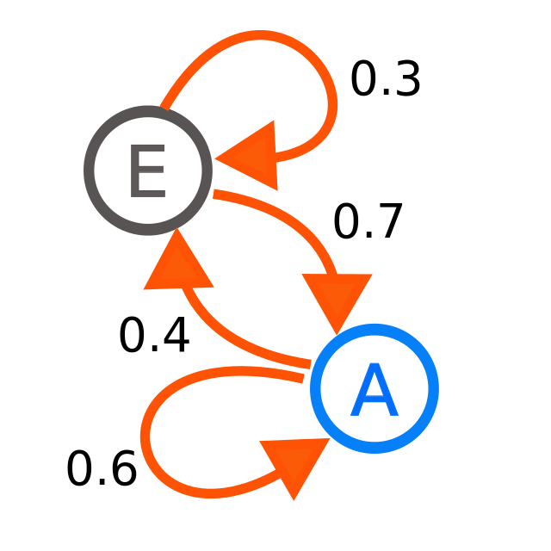
Markov Chains in Quantum Computing
A Markov chain is a mathematical model that describes a sequence of events where the probability of each event depends only on the state attained in the previous event.
Quantum walks can be used to simulate Markov chains in a quantum system. Quantum walks provide a quantum analog of the classical Markov chain where the transition probabilities are determined by quantum operations.
By using a quantum walk to simulate a Markov chain, we can potentially take advantage of quantum parallelism and speedup for specific problems that involve random walks.

Slide 5
Chernoff Bounds
In the context of Markov chains, the Chernoff bound is used to quantify the probability that the Markov chain behaves in a certain way or reaches a specific state within a given number of steps.
Let (Sum equation) be the sum of n independent random variables (representing the states in n time steps of the Markov chain). The Chernoff bound for the tail probability is often expressed as:
(Chernoff Bound Equation)

